Slide 1
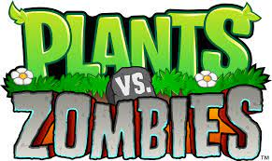
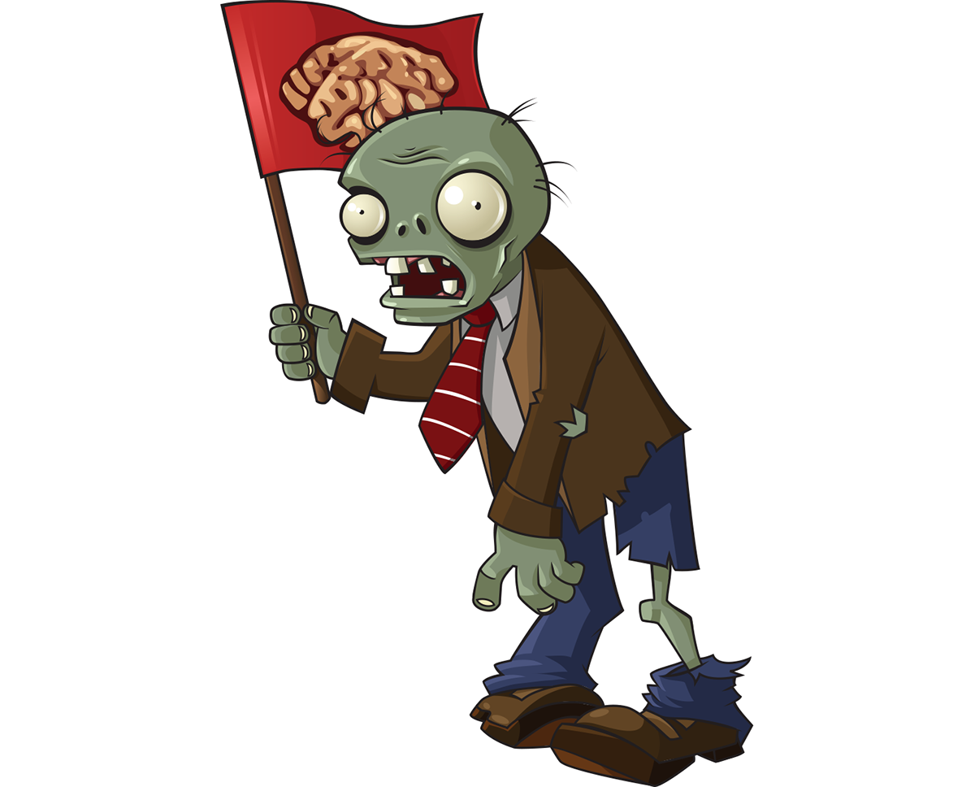

A remake by Aadil Hussain PLANTS VS ZOMBIES PLANT DEFENDERS: ELEKTRIFIED

Slide 2
Plants v Zombies – Plant Defenders: ELEKTRIFIED
Concept: A strategic tower defense game inspired by “Plants vs. Zombies”(PVZ) with an electrifying twist.
Will include all familiarly known mechanisms in the initial PVZ game but will layer additional features and game methods above to allow for user to feel a sense of familiarity while still renewing their interest profile.

Slide 3
FEATURES
Electric Fence Mechanism: A unique feature allowing players to activate a defense that zaps zombies, providing a break to recoup.
Diverse Plant Arsenal: A variety of plants with unique abilities to combat different zombie types.
Progressive Levels: Increasing difficulty with new zombies and challenges.

Slide 4
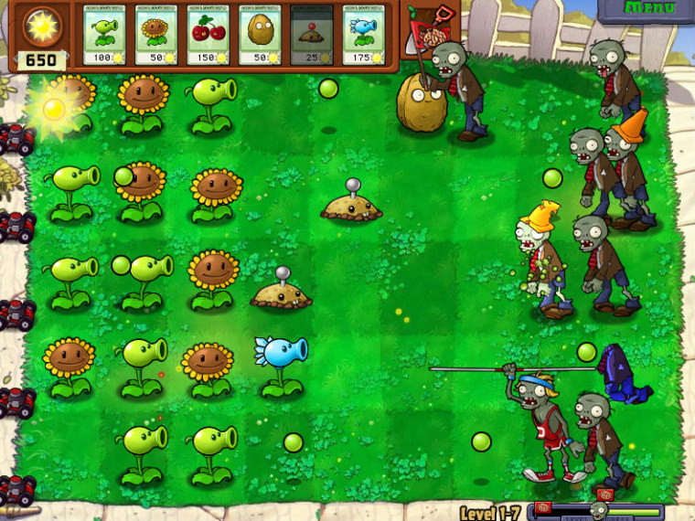

CONCEPT ART

Slide 5
TARGET AUDIENCE
Demographics: Primarily aimed at youth, as 2D - basic sandbox games are typically found attractive to such ages.
Can also aim at casual gamers of all ages who enjoy strategy and tower defense games.

Slide 6
COMPARISON GAMES - PVZ
Similarities: Shares core mechanics with “Plants vs. Zombies.”
Differences: Introduces the electric fence feature and other unique gameplay elements.

Slide 7
WHY INVEST IN US
Innovation: The electric fence adds a new layer of strategy not seen in similar games.
Market Potential: PVZ has been dormant for years, an extremely minor side game in 2023. With this, it will renew and bring life back to this game and will attract the fans of the genre back to it. During the initial period of launch, there is massive potential for sales to all audiences whether it be for playing, collecting, or renewing.
Media Attention: A surge influx of old players returning after years will create a spur amongst the trend of the ages and will draw media attention, driving more sales to our game.

Slide 8
TIMELINE
Can be produced in 3-4 weeks, timeline inclusive of data analytics monitoring system and any proprietary programming necessary for execution.

